Slide 1
JioMart Plus: Enhancing User Experience and Visual Appeal
Kanmani Angel S
angel.jayam@gmail.com

Slide 2
Introduction
JioMart is an e-commerce platform operated by Reliance Retail, providing a wide range of grocery and household products to customers across India. The platform aims to offer a convenient and seamless shopping experience.

Slide 3
Key Improvements
Streamlined Navigation
Enhanced Visual Design
Improved Product Presentation
Optimized Checkout Process

Slide 4
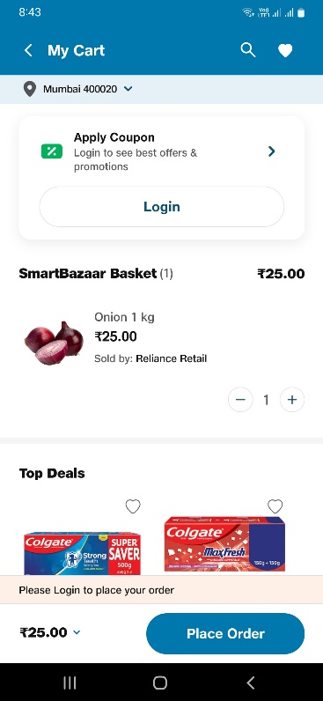
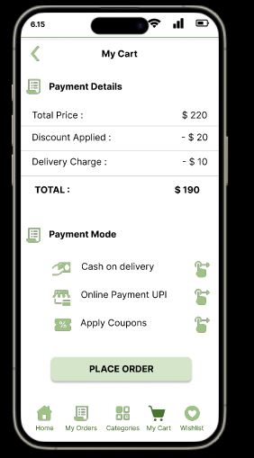
Visual comparison of the original and redesigned UI
Original UI
Redesigned UI

Slide 5
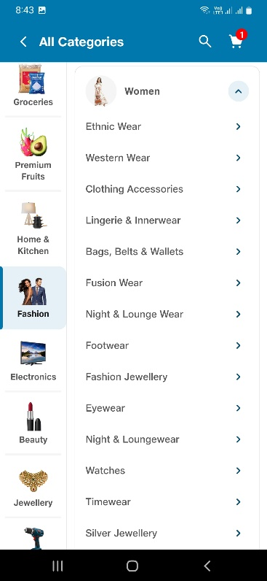
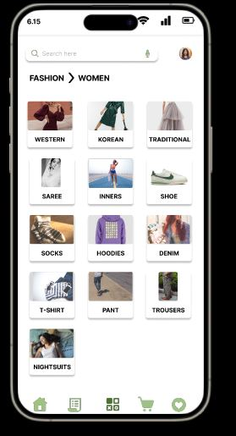
Visual comparison of the original and redesigned UI
Original UI
Redesigned UI

Slide 6
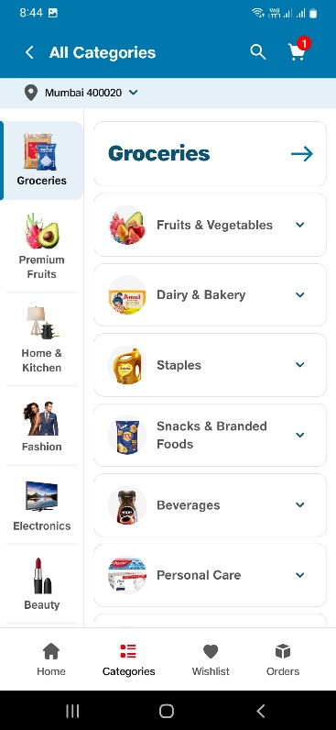
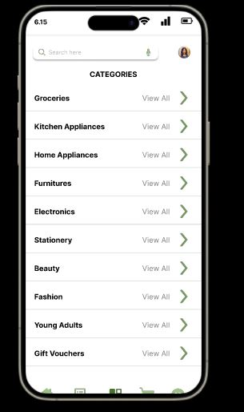
Visual comparison of the original and redesigned UI
Original UI
Redesigned UI

Slide 7
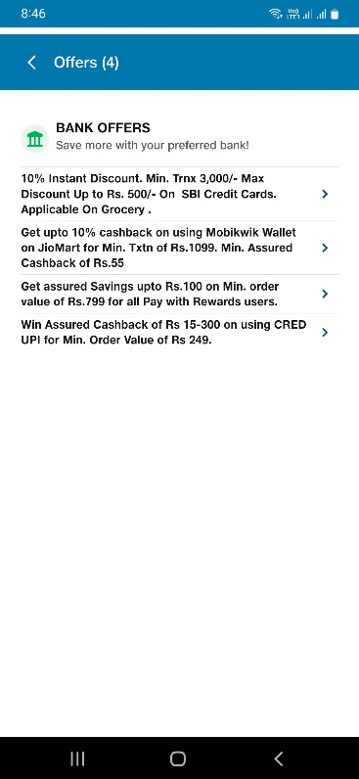
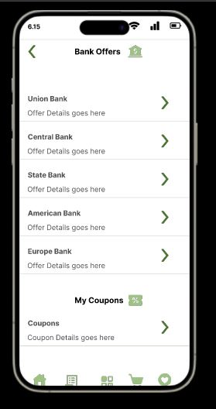
Visual comparison of the original and redesigned UI
Original UI
Redesigned UI

Slide 8
Usability Testing
Navigation Simplification
Visual Enhancements
Product Presentation
Checkout Process Optimization
While formal usability testing was not conducted, informal feedback from a group of friends and potential users played a crucial role in shaping the redesign of the JioMart app. Key insights and suggestions from users influenced several aspects of the redesign.
By actively soliciting and incorporating user feedback throughout the redesign process, the JioMart app was tailored to better meet the needs and preferences of its target audience. User-centric design decisions driven by feedback ultimately led to a more user-friendly and engaging shopping experience.

Slide 9
Implementation Plan
UI/UX Design Phase
Development Phase
Testing and Quality Assurance
Deployment and Rollout

Slide 10
User-Centric Solutions
The changes such as Streamlined Navigation, Enhanced Visual Design, Improved Product Presentation and Optimized Checkout Process collectively contribute to a user-centric design approach, ensuring that every interaction with the JioMart app is intuitive, efficient and enjoyable. By addressing usability pain points and enhancing visual clarity, the redesigned app aims to provide a superior shopping experience for all users.

Slide 11
Links to all the resources
Figma : https://www.figma.com/file/hEleKdOdMZ34ILn5EIiVyq/Excelerate-Redesign-Challenge?type=design&node-id=0%3A1&mode=design&t=0X44tm8LTpcJPKOG-1
GitHub : https://github.com/AngelKA00/UI-UX-Designs/tree/main/JioMart%20Redesign%20Challenge

Slide 12
Conclusion
The redesign of the JioMart app was undertaken to elevate user experiences and enhance the visual representation of the platform. The goal was to streamline navigation, improve usability and modernize the overall look to align with contemporary design trends.

Slide 13
Thank You

